Slide 1
Section 11.3 The Integral Test and Estimates of Sums
Lecture 1
Integral Test

Slide 2

Section 11.3 Homework Submission to Canvas
Preview of section​
Skim section, write short paragraph summary, list all important definitions / theorems / formulas.​
Notes on video lectures​
Include all details, worked examples, your own thoughts​
Worked examples from text​
Solutions to exercises​
Final reflection of section​
List of key takeaways to remember​

Slide 3
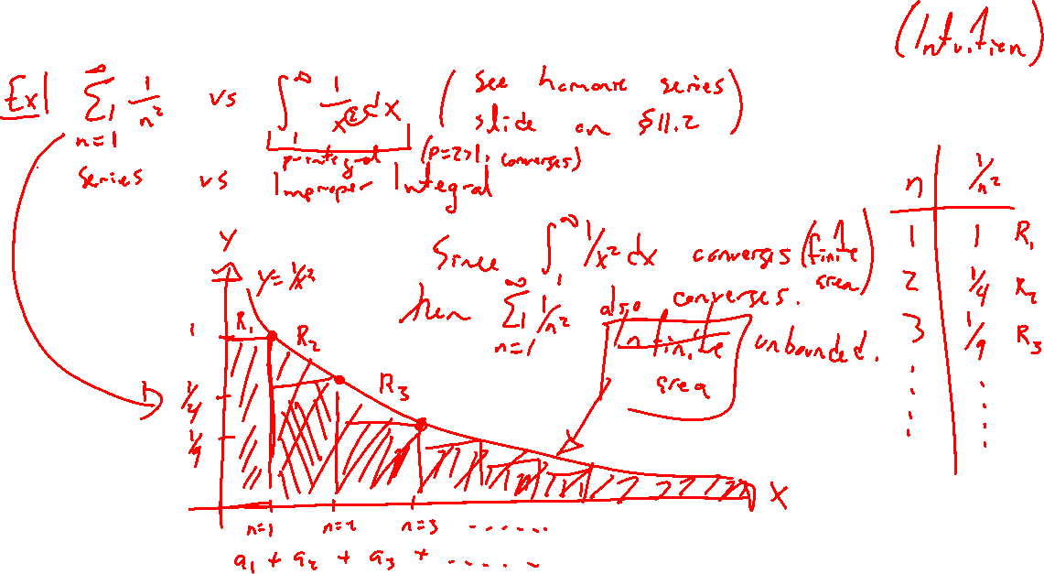
Series Compared to Improper Integrals
Notes:
Harmonic series example for divergence.
1/n^2 for convergence. Do this example carefully later.

Slide 4
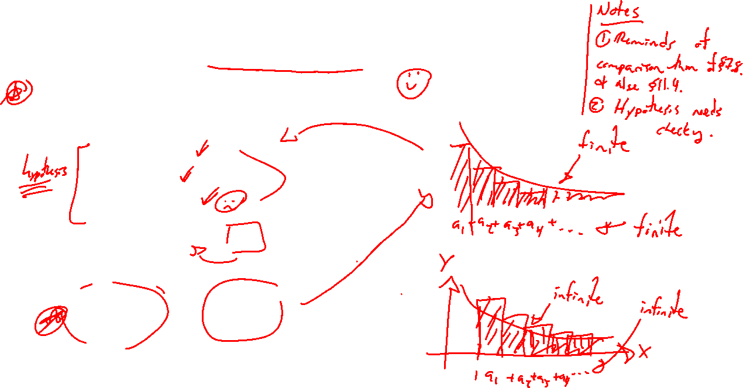
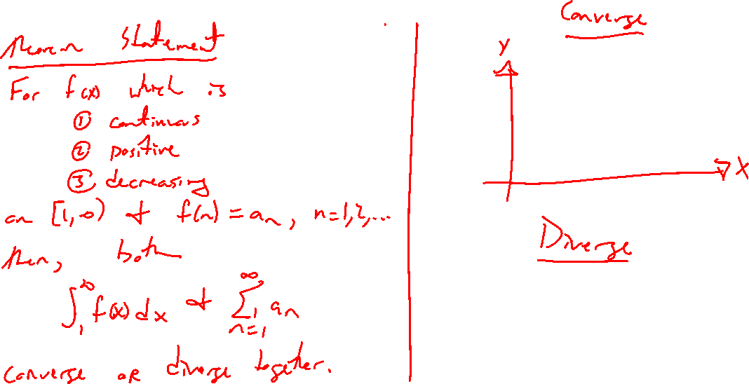
Theorem: Integral Test
Notes:
For f continuous, positive, decreasing function on [1,infty), let a_n = f(n).
Then series for a_n and improper integral for f either both converge or both diverge.
Proof in text involves monotone seq theorem of past.

Slide 5
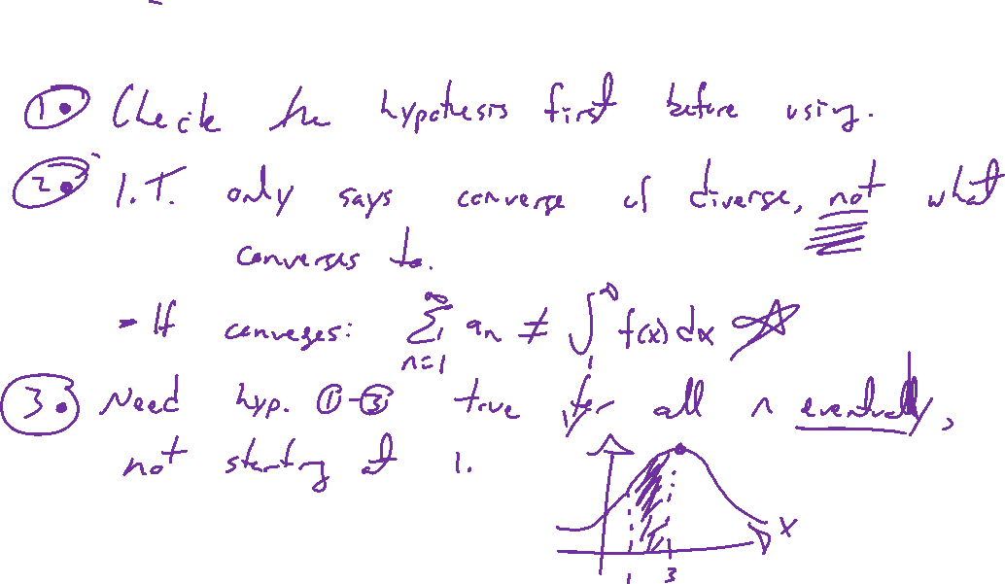
Notes on Integral Test
Notes:
Remember to check hypothesis before using.
Only says converge / diverge, not what to. This is the theme of result of chapter (series TESTS).
Decreasing only matters eventually. First few terms don't effect conver/diver

Slide 6
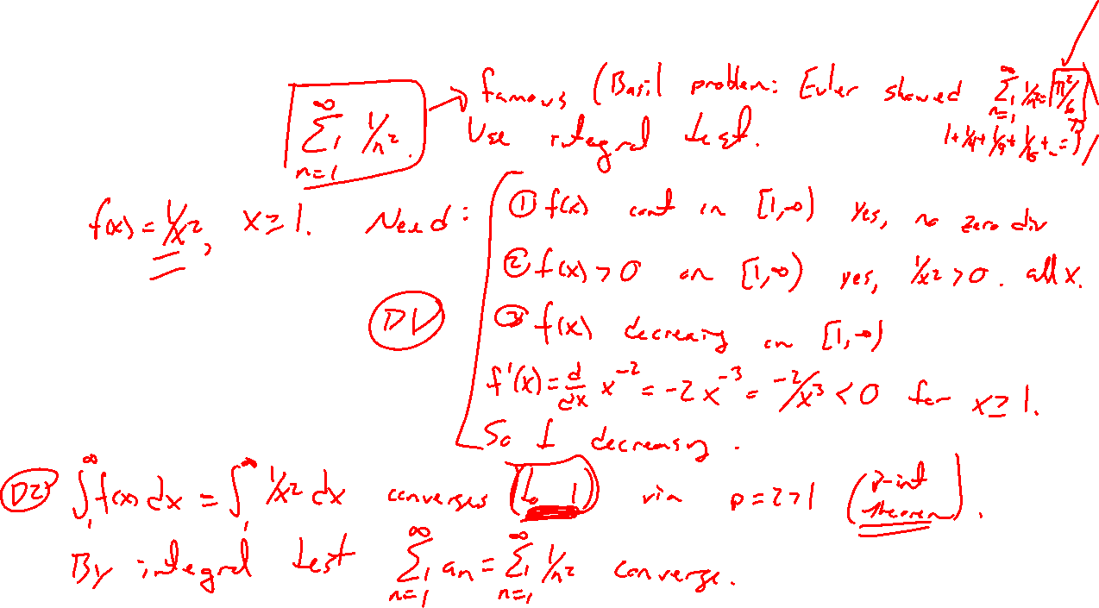
Example:
Notes:
1/n^2 done carefully.
Check the hypothesis of integral test works.
Famous example, Euler and the Basil Problem, sum is pi^2/6
https://en.wikipedia.org/wiki/Basel_problem

Slide 7
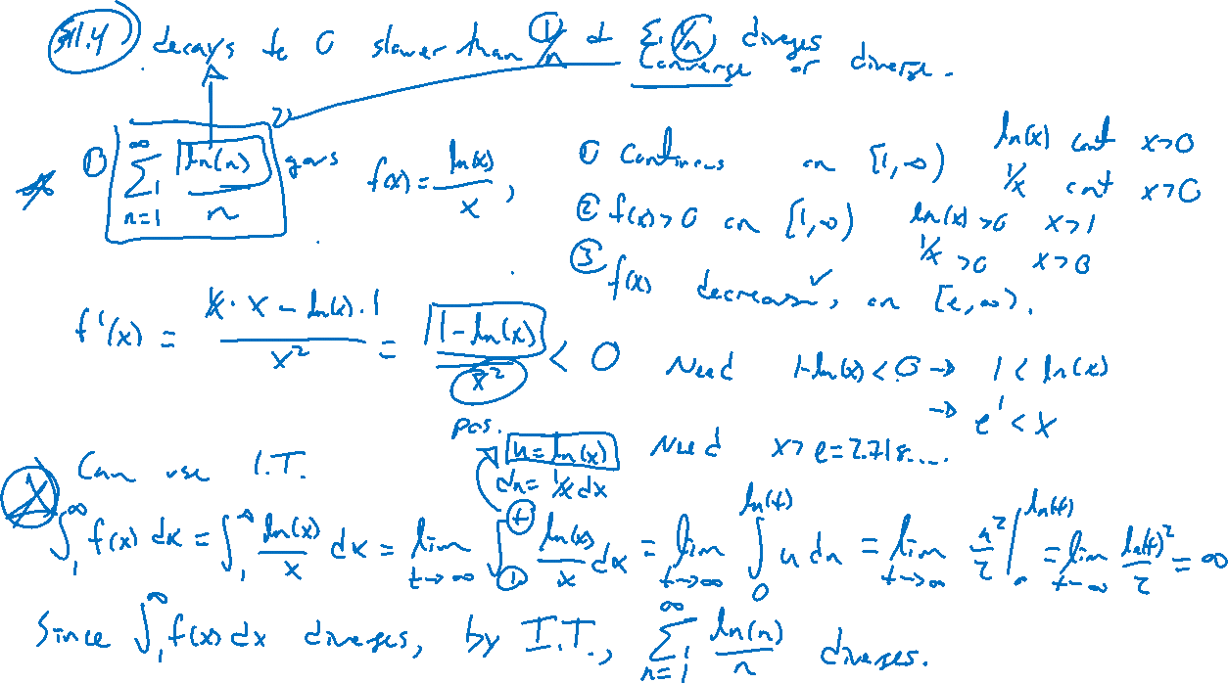
Examples: Try on own.
Notes:
ln(n)/n (should diverge since goes to zero slower than 1/n)
1/(n^2+4) (should converge)

Slide 8
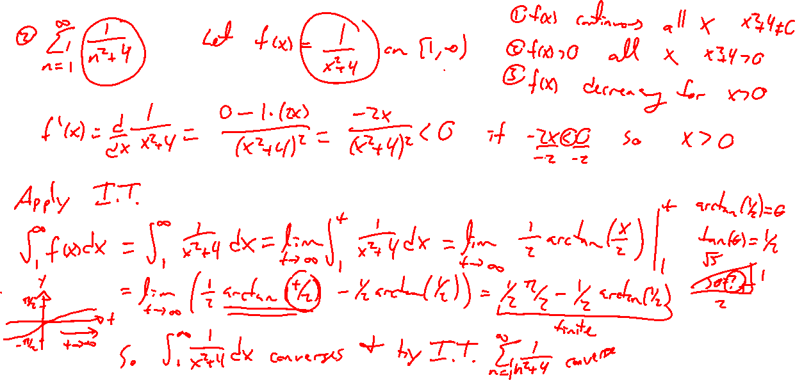
Examples: Try on own.
Notes:
ln(n)/n (should diverge since goes to zero slower than 1/n)
1/(n^2+4) (should converge)

Slide 9
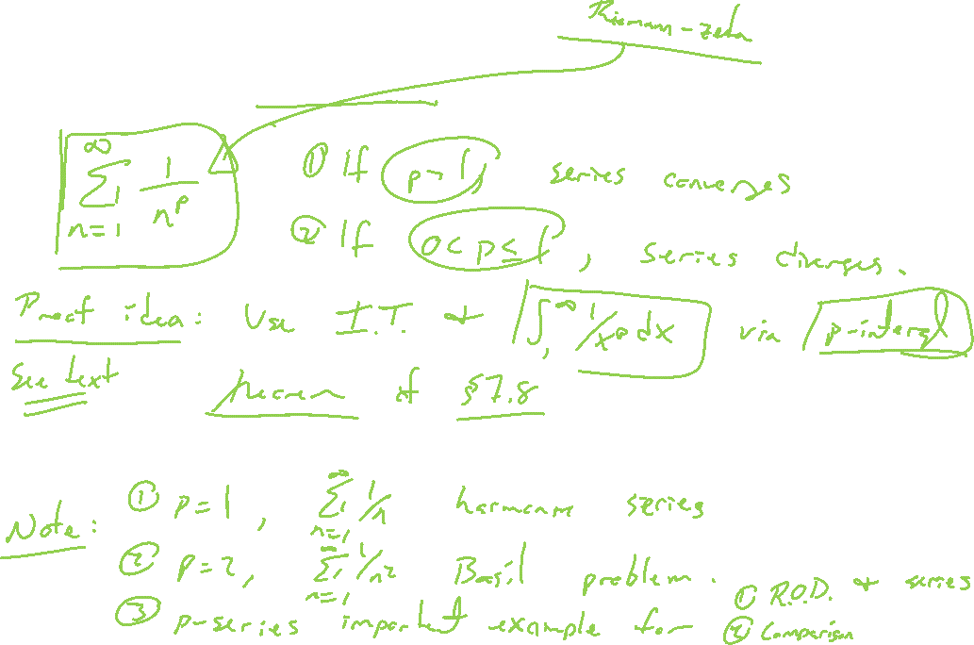
Theorem: p-series
Notes:
Relate to p-integrals of 7.8. Again this is about rate of decay.
Important benchmark results for intuition.
https://en.wikipedia.org/wiki/Riemann_zeta_function
https://www.youtube.com/watch?v=sD0NjbwqlYw
https://en.wikipedia.org/wiki/Riemann_hypothesis
https://en.wikipedia.org/wiki/Millennium_Prize_Problems

